Slide 1

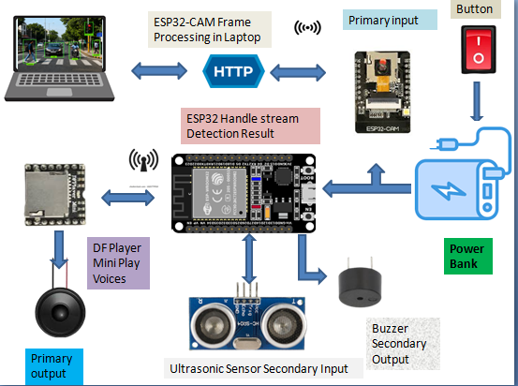
iOt & Computer Vision Based Smart stick for visually impaired persons
Muhammad Amir Mushtaq(F22BINCE1M02019), Shanza Shafiq(F22BINCE1M02017)
{mamirobotics, shanzashafiq53}@gmail.com
DEPARTMENT OF INFORMATION AND COMMUNICATION ENGINEERING
The Islamia University of Bahawalpur, Pakistan
Introduction
Systematic Diagram
Experimental Results and Discussion
For visually impaired individuals require assistive technologies to safely navigate their surroundings. This project proposes an IoT, and Computer Vision based Smart Stick that detects nearby objects using live video and provides real-time audio feedback. The system uses an ESP32-CAM for image acquisition and a Python-based computer vision server for object recognition.
The system accurately detects common objects with different datasets such as:
1.Persons
2.Vehicles
3.Chairs
4.Laptop etc
Audio feedback is generated in real time with minimal delay.
Project Objectives
Real-time object detection using live camera feedback
Identification of common obstacles (person, car, chair, stairs)
Audio-based feedback for user awareness
Conclusion and Perspectives
Conclusion
The proposed smart stick provides real-time environmental awareness for visually impaired users.
Computer vision enables accurate detection and classification of surrounding objects.
Audio feedback allows users to respond safely to detected obstacles.
The system is portable and operates using low-cost hardware components.
Proposed Method
ESP32-CAM captures live video
Video stream is sent wirelessly to PC
Python processes frames using computer vision algorithms
Objects are detected and classified
Send feedback to ESP32 it send to the DF Mini Player
DF Mini Player plays corresponding voice feedback
Go to the next iteration
(Loop)
Power
Initialize
HTTP
ESP32-CAM
Future Direction
On-device AI inference will use Raspberry Pi
Distance estimation for obstacles
GPS-based navigation support
Smartphone application integration
Laptop
(Processing)
Classification
Project Cost
Acknowledgement
DF Player
Description | Cost in (PKR)
ESP32 cam, ESP32 | 2750/-
DF Mini Player , 2w Mini Speaker, Memory Card | 1500/-
Power Bank | 2500/-
Cell(Power bank), Cell case, Stick, etc | 1550/-
Ultrasonic sensor, Buzzer, PVC pipe, box, Poster, Thesis | 2000/-
Total | 8050/-
We sincerely thank our project supervisor for their valuable guidance and support throughout this project. We also acknowledge our department and institution for providing the necessary resources and facilities.
Audio Feedback to esp32
Sound
Supervisor:
Dr. Abdul Aziz (Associate Professor)
Department of Information & Communication Engineering
Email: abdul.aziz@iub.edu.pk
Final Year Project , 21 January 2026, Faculty of Engineering, The Islamia University of Bahawalpur, Pakistan.

